Slide 1
The Bender Rule, Low Resource Languages and Growth Languages
JSALT-2025
Kenneth Church

Slide 2
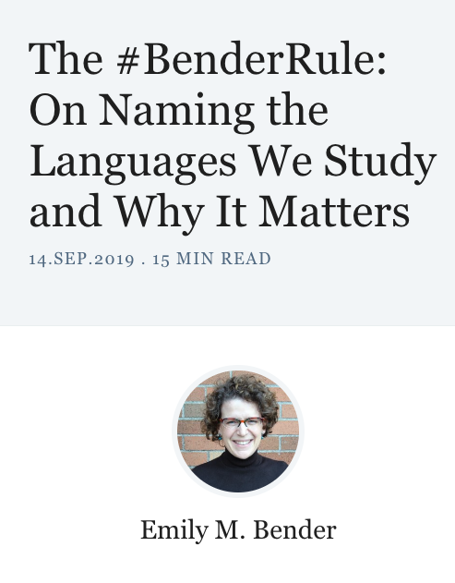
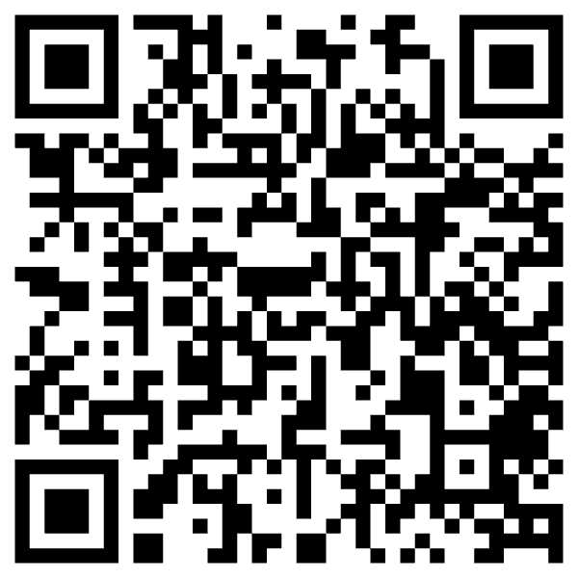
Criticism: ACL is too focused on English https://thegradient.pub/the-benderrule-on-naming-the-languages-we-study-and-why-it-matters/

Slide 3
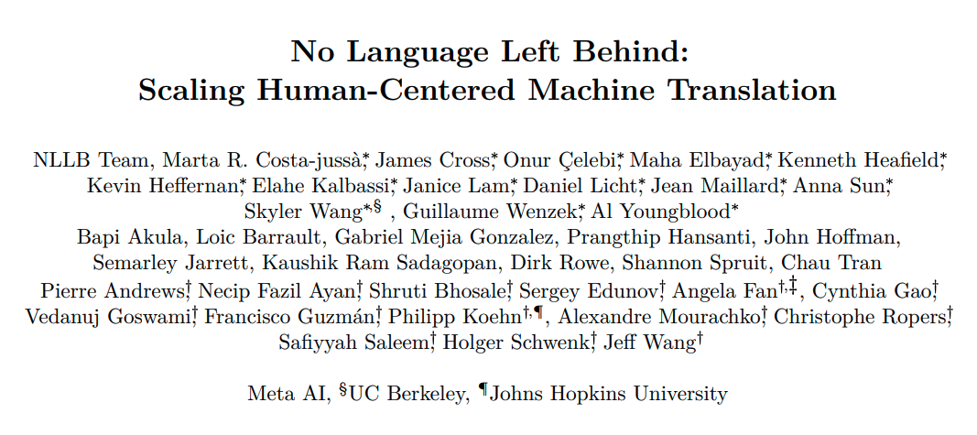
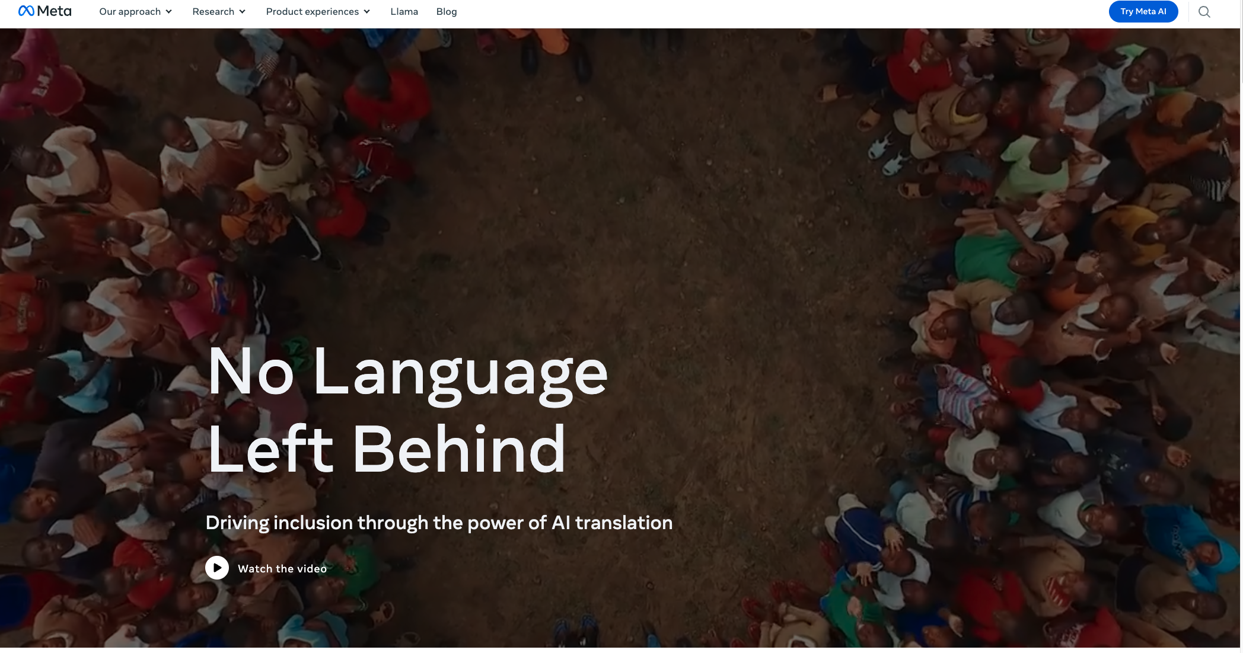
No Language Left Behind (NLLB)

Slide 4
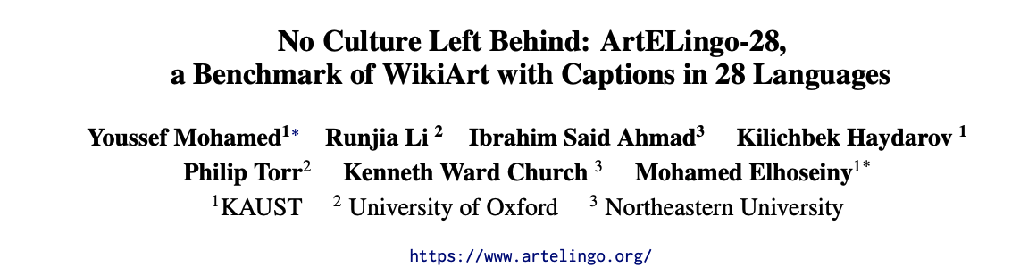
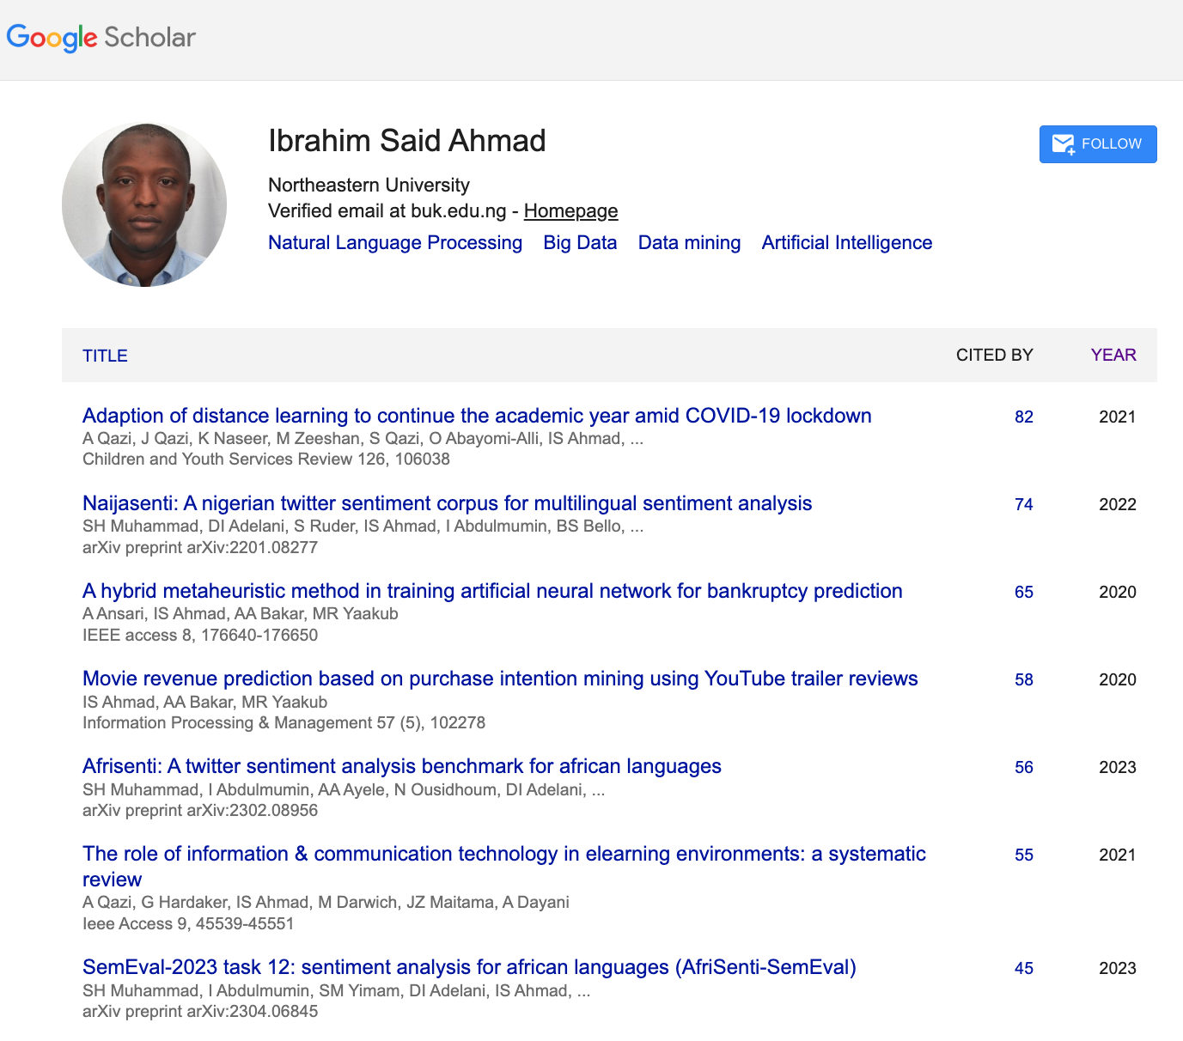
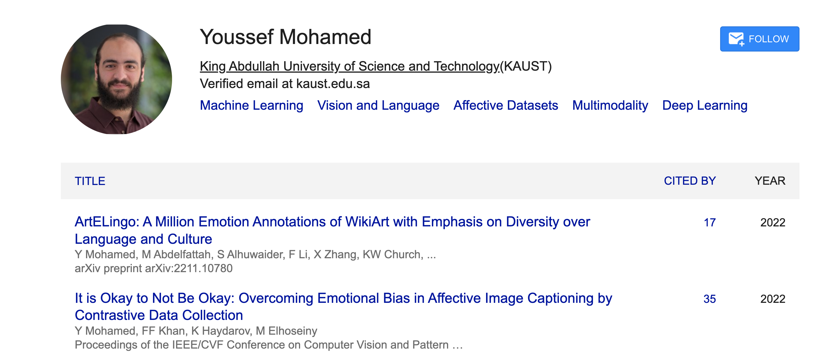
JSALT-2025 Teamwork Opportunity: Zoom → Face-to-Face

Slide 5

Move Fast and Break Things (Colonialism)
Irresponsible AI

Slide 6
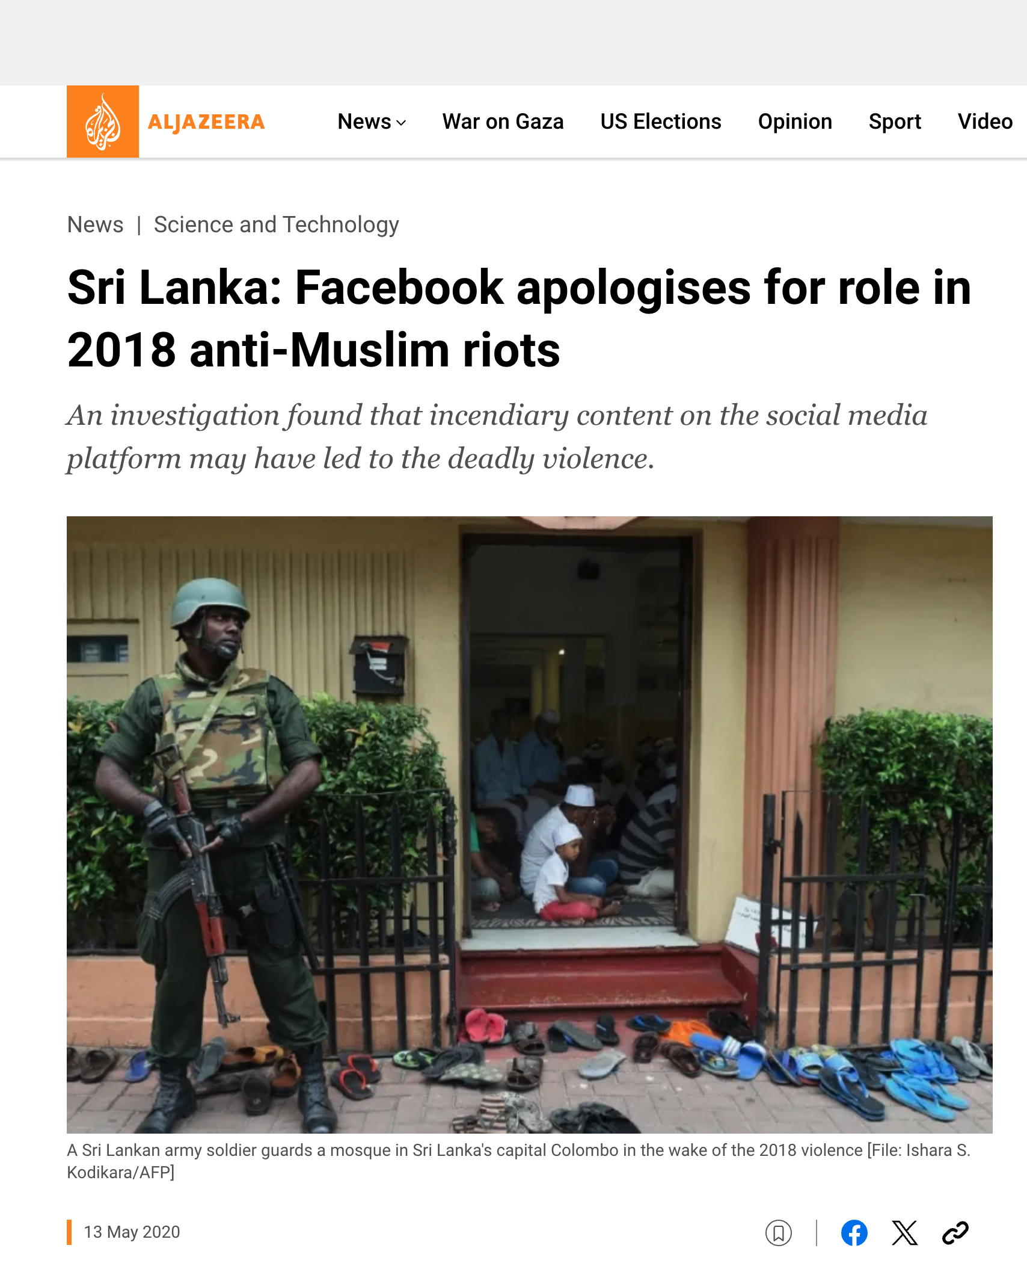

Deadly Consequences

Slide 7
Concerns
Responsible AI (deadly and insanely profitable)
Data quality
Too much machine translation
Too few quality controls (by people with local expertise)
Lack of Expertise in Languages and Cultures
Too much Emphasis on Translation
Is it appropriate to use English as a pivot language
Is there a single model to rule them all?
Covering multiple perspectives

